Slide 1

Modern Analytics Academy “Vignettes”
Follow up to Modern Analytics Academy: https://aka.ms/maa
Topical sessions that addresses:
New features and how to use them
Frequent questions we receive
Updates to a previous session
Brian Hitney
Senior Cloud Solution Architect

Slide 2
Modern Analytics Academy “Vignettes”
Data Governance Overview
https://aka.ms/maa
Brian Hitney
Senior Cloud Solution Architect

Slide 3





Academy Sessions
Acquisition & Storage
Modeling
Pipelines
Security & Governance
Visualization
Azure Data Lake
Azure Cosmos DB
Azure Event Hubs
Synapse Link
Data Lake Structure
Synapse Spark Pools
Synapse SQL Pools
Synapse Serverless SQL
Azure Data Factory
Synapse Pipelines
Power BI Dataflows
Azure Stream Analytics
Auditing
Security
Azure Purview
Power BI
Paginated Reports
Power BI Embedded
What exactly is Data Governance? Why do we need it?
How do we get started with Data Governance within an organization?
What is Master Data?

Slide 4
Agenda
What is data governance and why do we need it?
Requirements for governing data in a modern enterprise
A data governance framework
Managing master data
Technology needed for end-to-end data governance
This presentation is intended for those seeking to understand the basics of Data Governance, technical decision makers and IT management. We will not be diving into Apache Atlas APIs, catalog management, or managing data lineage.

Slide 5
What is data governance?
“Data Governance is defined as the exercise of authority and control (planning, monitoring, and enforcement) over the management of data assets.”
Source: DAMA Data Management Body of Knowledge V2 (DMBOK2)
“Data governance encompasses the people, processes, and technology required to create a consistent and proper handling of an organization's data across the business enterprise.”
Source: Wikipedia
“Data governance is the orchestration of people, processes, policies and technology to formally manage and protect structured and unstructured data assets to guarantee commonly understood, trusted and secure data throughout the enterprise”
Source: Mike Ferguson, Intelligent Business Strategies

Slide 6
Digital transformation is having a profound impact on business
Engage customers
Optimize operations
Digital capability
Empower employees
Transform products

Slide 7
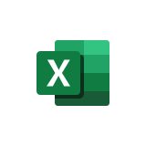


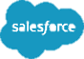

Managing/integrating data is becoming increasingly complex as data sources grow
More data sources now need to be integrated to provide information for business use
Legacy
applications
Office
documents
Web content
ECMS
Flat files
Big data applications
Cloud based
applications
E-mail
DW/BI systems
JSON
RDBMSs
Packaged
applications
Digital media

Slide 8
A hybrid multi-cloud setup is becoming the norm
The movement to multiple clouds will continue to increase, to obtain cloud-based services from different cloud vendors
0-1 Clouds
0.5%
Multiple private/ dedicated clouds
Multiple public clouds only
24%
2%
One public cloud + one or more private/dedicated clouds
11%
2-9 Clouds
7.5%
68%
70%
81%
10+ Clouds
Multiple public cloud + one or more private/dedicated clouds
9%
28%
Now
In 3 years
Source: IBV 2018 Multicloud management survey, Q2 & Q3
n = 200 United States-based enterprise multicloud users
Source: IDC’s Multicloud Management Survey, 2019

Slide 9
Data flow is more complex
Data must flow between transaction systems for processes to execute and needs to be integrated into analytical systems
Things
data
Data needs to flow between edge devices, systems on-premises and in the cloud
On-premises
Cloud
Cloud
Cloud
data
data
data
data
On-premises
On-premises
Cloud
On-premises

Slide 10


Data is born

Slide 11


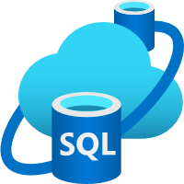
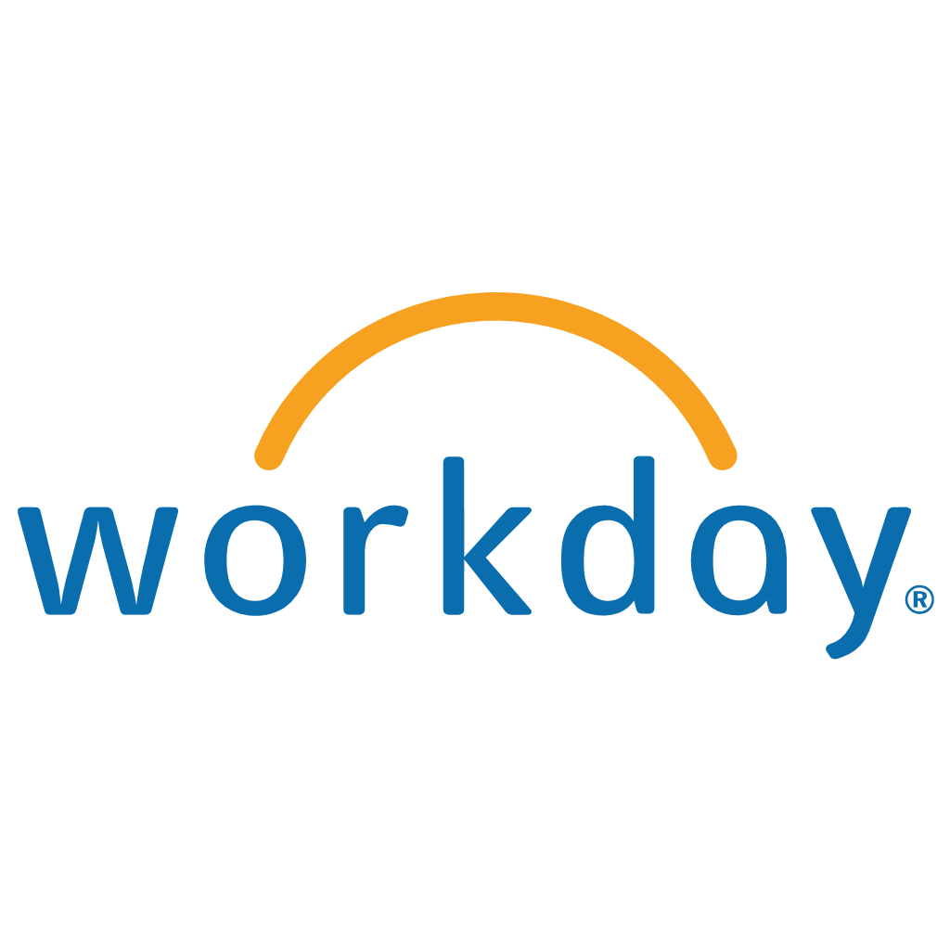
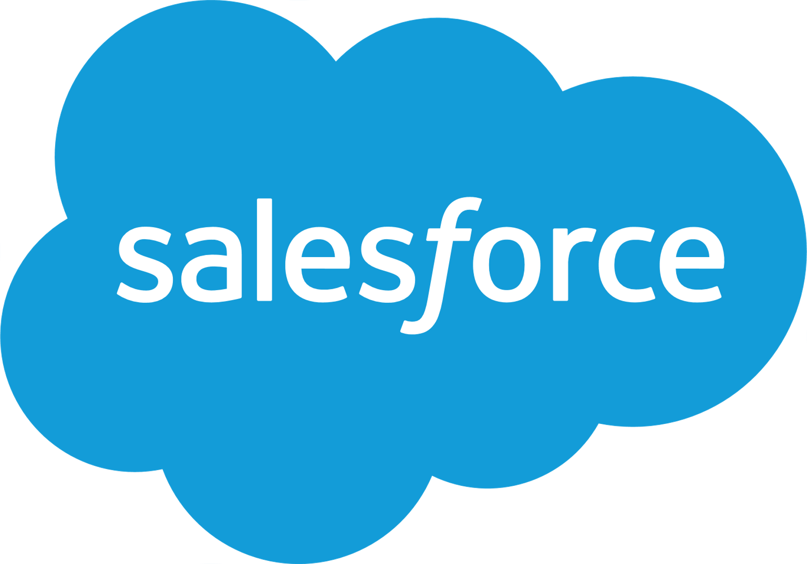
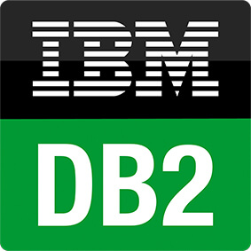

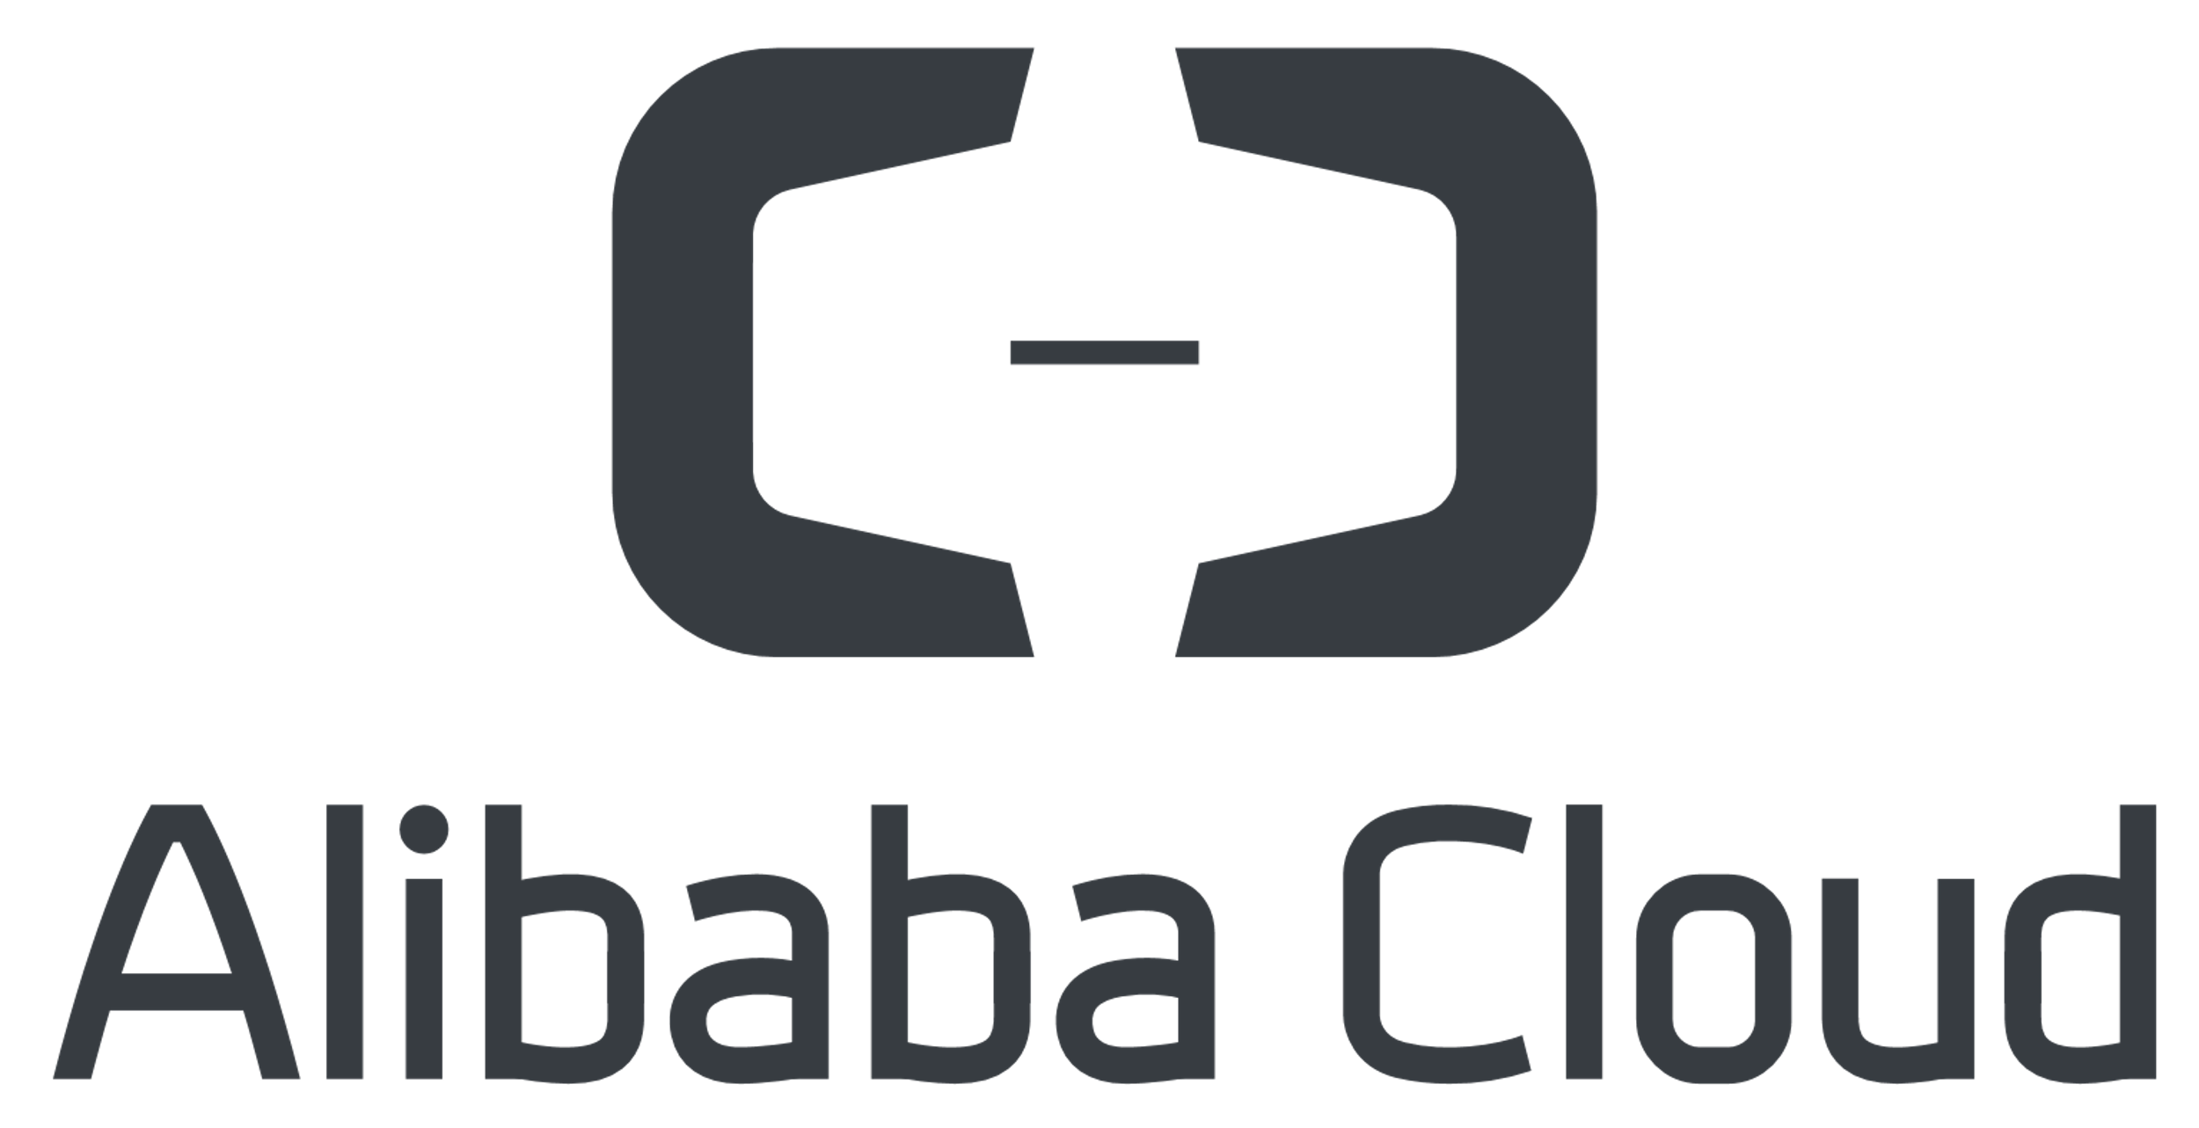




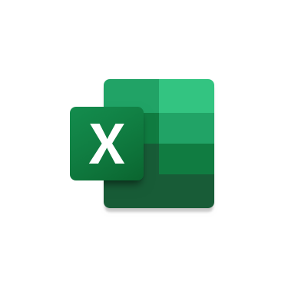




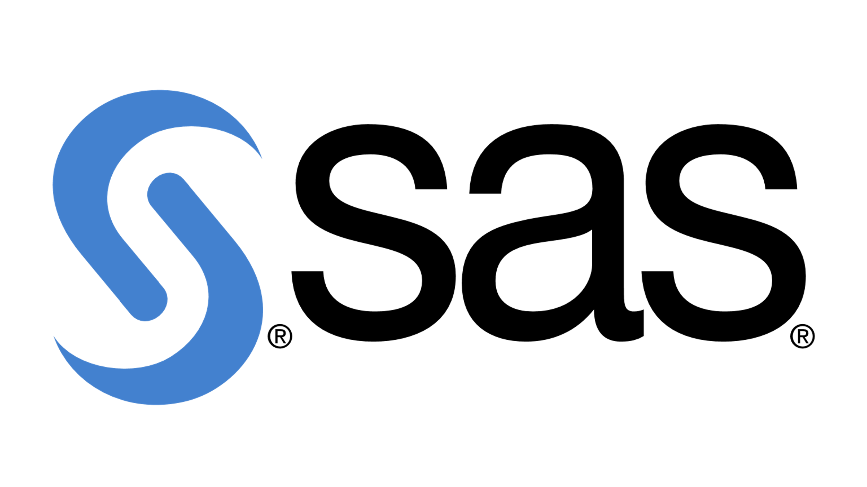
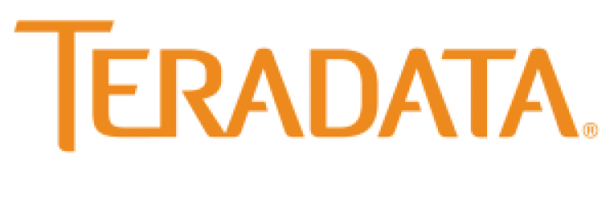






Azure SQL
Azure Health Data Services
Azure SQL DB Edge
SaaS (LOB)
Mainframe
Other clouds
Campaign data, conversion data
Third-party data (digital media, enrichment and apps)
Azure Cosmos DB
Dynamics 365
Azure DB for MySQL
Excel CSV
Store
Analytics
Data sources
Microsoft 365
Azure DB for MariaDB
…
Social Media
Edge
…
Data is born
Data under Microsoft Management
Internal first-party
Second-party
External third-party

Slide 12


Data ingest
Batch ingestion service
Real-time streaming data
Azure SQL
Azure Health Data Services
Azure SQL DB Edge
SaaS (LOB)
Mainframe
Other clouds
Campaign data, conversion data
Third-party data (digital media, enrichment and apps)
Azure Cosmos DB
Dynamics 365
Azure DB for MySQL
Excel CSV
Store
Analytics
Data sources
Microsoft 365
Azure DB for MariaDB
…
Social Media
Edge
…
Data is born
Data under Microsoft Management
Internal first-party
Second-party
External third-party

Slide 13



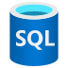




Spark
SQL
Stream Analytics
API/ Microservices
HD Insight Clusters
Stream Analytics
Azure Data Explorer Clusters
Azure SQL
CDM Profile unification | Signalization | Segmentation
Synapse Link
Last 1,000 records
Last 15 min
Logical data warehouse & Data lake
Data store, processing & access
Azure Cosmos DB
Azure Health Data Services
Azure DB for MariaDB
Azure SQL DB Edge
Azure DB for MySQL
Data lake
Analytics-optimized
Update-optimized
Change feed
Event Based Processing
Data ingest
Batch ingestion service
Real-time streaming data
Azure SQL
Azure Health Data Services
Azure SQL DB Edge
SaaS (LOB)
Mainframe
Other clouds
Campaign data, conversion data
Third-party data (digital media, enrichment and apps)
Azure Cosmos DB
Dynamics 365
Azure DB for MySQL
Excel CSV
Store
Analytics
Data sources
Microsoft 365
Azure DB for MariaDB
…
Social Media
Edge
…
Data is born
Data under Microsoft Management
Internal first-party
Second-party
External third-party

Slide 14

Machine Learning
Data analytics
Model dev./ training
Offline
Offline
Model scoring
Offline featurization
Featurization
Model
Model training
Model optimization
Deployment
Policies
Featurization
Model
Spark
SQL
Stream Analytics
API/ Microservices
HD Insight Clusters
Stream Analytics
Azure Data Explorer Clusters
Azure SQL
CDM Profile unification | Signalization | Segmentation
Synapse Link
Last 1,000 records
Last 15 min
Logical data warehouse & Data lake
Data store, processing & access
Azure Cosmos DB
Azure Health Data Services
Azure DB for MariaDB
Azure SQL DB Edge
Azure DB for MySQL
Data lake
Analytics-optimized
Update-optimized
Data store, processing & access
Change feed
Event Based Processing
Data ingest
Batch ingestion service
Real-time streaming data
Azure SQL
Azure Health Data Services
Azure SQL DB Edge
SaaS (LOB)
Mainframe
Other clouds
Campaign data, conversion data
Third-party data (digital media, enrichment and apps)
Azure Cosmos DB
Dynamics 365
Azure DB for MySQL
Excel CSV
Store
Analytics
Data sources
Microsoft 365
Azure DB for MariaDB
…
Social Media
Edge
…
Data is born
Data under Microsoft Management
Internal first-party
Second-party
External third-party

Slide 15
Data visualization
Notebooks
Adhoc Queries
Real-time insights and alerts
Business specific reports
Data consumption
Machine Learning
Data analytics
Model dev./ training
Offline
Offline
Model scoring
Offline featurization
Featurization
Model
Model training
Model optimization
Deployment
Policies
Featurization
Model
Spark
SQL
Stream Analytics
API/ Microservices
HD Insight Clusters
Stream Analytics
Azure Data Explorer Clusters
Azure SQL
CDM Profile unification | Signalization | Segmentation
Synapse Link
Last 1,000 records
Last 15 min
Logical data warehouse & Data lake
Data store, processing & access
Azure Cosmos DB
Azure Health Data Services
Azure DB for MariaDB
Azure SQL DB Edge
Azure DB for MySQL
Data lake
Analytics-optimized
Update-optimized
Data store, processing & access
Change feed
Event Based Processing
Data ingest
Batch ingestion service
Real-time streaming data
Azure SQL
Azure Health Data Services
Azure SQL DB Edge
SaaS (LOB)
Mainframe
Other clouds
Campaign data, conversion data
Third-party data (digital media, enrichment and apps)
Azure Cosmos DB
Dynamics 365
Azure DB for MySQL
Excel CSV
Store
Analytics
Data sources
Microsoft 365
Azure DB for MariaDB
…
Social Media
Edge
…
Data is born
Data under Microsoft Management
Internal first-party
Second-party
External third-party

Slide 16

Analytics Platform
Data visualization
Notebooks
Adhoc Queries
Real-time insights and alerts
Business specific reports
Data consumption
Machine Learning
Data analytics
Model dev./ training
Offline
Offline
Model scoring
Offline featurization
Featurization
Model
Model training
Model optimization
Deployment
Policies
Featurization
Model
Spark
SQL
Stream Analytics
API/ Microservices
HD Insight Clusters
Stream Analytics
Azure Data Explorer Clusters
Azure SQL
CDM Profile unification | Signalization | Segmentation
Synapse Link
Last 1,000 records
Last 15 min
Logical data warehouse & Data lake
Data store, processing & access
Azure Cosmos DB
Azure Health Data Services
Azure DB for MariaDB
Azure SQL DB Edge
Azure DB for MySQL
Data lake
Analytics-optimized
Update-optimized
Data store, processing & access
Change feed
Event Based Processing
Data ingest
Batch ingestion service
Real-time streaming data
Azure SQL
Azure Health Data Services
Azure SQL DB Edge
SaaS (LOB)
Mainframe
Other clouds
Campaign data, conversion data
Third-party data (digital media, enrichment and apps)
Azure Cosmos DB
Dynamics 365
Azure DB for MySQL
Excel CSV
Store
Analytics
Data sources
Microsoft 365
Azure DB for MariaDB
…
Social Media
Edge
…
Data is born
Data under Microsoft Management
Internal first-party
Second-party
External third-party

Slide 17
Analytics Platform
Data visualization
Notebooks
Adhoc Queries
Real-time insights and alerts
Business specific reports
Data consumption
Machine Learning
Data analytics
Model dev./ training
Offline
Offline
Model scoring
Offline featurization
Featurization
Model
Model training
Model optimization
Deployment
Policies
Featurization
Model
Spark
SQL
Stream Analytics
API/ Microservices
HD Insight Clusters
Stream Analytics
Azure Data Explorer Clusters
Azure SQL
CDM Profile unification | Signalization | Segmentation
Synapse Link
Last 1,000 records
Last 15 min
Logical data warehouse & Data lake
Data store, processing & access
Azure Cosmos DB
Azure Health Data Services
Azure DB for MariaDB
Azure SQL DB Edge
Azure DB for MySQL
Data lake
Analytics-optimized
Update-optimized
Data store, processing & access
Change feed
Event Based Processing
Data ingest
Batch ingestion service
Real-time streaming data
Azure SQL
Azure Health Data Services
Azure SQL DB Edge
SaaS (LOB)
Mainframe
Other clouds
Campaign data, conversion data
Third-party data (digital media, enrichment and apps)
Azure Cosmos DB
Dynamics 365
Azure DB for MySQL
Excel CSV
Store
Analytics
Data sources
Microsoft 365
Azure DB for MariaDB
…
Social Media
Edge
…
Data is born
Data under Microsoft Management
Internal first-party
Second-party
External third-party

Slide 18
Analytics Platform
Data visualization
Notebooks
Adhoc Queries
Real-time insights and alerts
Business specific reports
Data consumption
Machine Learning
Data analytics
Model dev./ training
Offline
Offline
Model scoring
Offline featurization
Featurization
Model
Model training
Model optimization
Deployment
Policies
Featurization
Model
Spark
SQL
Stream Analytics
API/ Microservices
HD Insight Clusters
Stream Analytics
Azure Data Explorer Clusters
Azure SQL
CDM Profile unification | Signalization | Segmentation
Synapse Link
Last 1,000 records
Last 15 min
Logical data warehouse & Data lake
Data store, processing & access
Azure Cosmos DB
Azure Health Data Services
Azure DB for MariaDB
Azure SQL DB Edge
Azure DB for MySQL
Data lake
Analytics-optimized
Update-optimized
Data store, processing & access
Change feed
Event Based Processing
Data ingest
Batch ingestion service
Real-time streaming data
Azure SQL
Azure Health Data Services
Azure SQL DB Edge
SaaS (LOB)
Mainframe
Other clouds
Campaign data, conversion data
Third-party data (digital media, enrichment and apps)
Azure Cosmos DB
Dynamics 365
Azure DB for MySQL
Excel CSV
Store
Analytics
Data sources
Microsoft 365
Azure DB for MariaDB
…
Social Media
Edge
…
Data is born
Multi-cloud offering
Data under Microsoft Management
Internal first-party
Second-party
External third-party

Slide 19
Analytics Platform
Data visualization
Notebooks
Adhoc Queries
Real-time insights and alerts
Business specific reports
Data consumption
Machine Learning
Data analytics
Model dev./ training
Offline
Offline
Model scoring
Offline featurization
Featurization
Model
Model training
Model optimization
Deployment
Policies
Featurization
Model
Spark
SQL
Stream Analytics
API/ Microservices
HD Insight Clusters
Stream Analytics
Azure Data Explorer Clusters
Azure SQL
CDM Profile unification | Signalization | Segmentation
Synapse Link
Last 1,000 records
Last 15 min
Logical data warehouse & Data lake
Data store, processing & access
Azure Cosmos DB
Azure Health Data Services
Azure DB for MariaDB
Azure SQL DB Edge
Azure DB for MySQL
Data lake
Analytics-optimized
Update-optimized
Data store, processing & access
Change feed
Event Based Processing
Data ingest
Batch ingestion service
Real-time streaming data
Azure SQL
Azure Health Data Services
Azure SQL DB Edge
SaaS (LOB)
Mainframe
Other clouds
Campaign data, conversion data
Third-party data (digital media, enrichment and apps)
Azure Cosmos DB
Dynamics 365
Azure DB for MySQL
Excel CSV
Store
Analytics
Data sources
Microsoft 365
Azure DB for MariaDB
…
Social Media
Edge
…
Data is born
Multi-cloud offering
Data Quality
Data Lineage
Data Metadata
Data Policy
Data governance and security
Data under Microsoft Management
Internal first-party
Second-party
External third-party

Slide 20

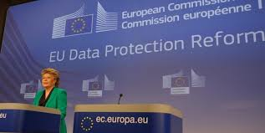



Why do we need enterprise data governance?
Companies Now Must Protect Personally Identifiable Information (PII)
Recently placed into law, the California Consumer Privacy Act grants California residents new rights with respect to the collection of their personal information.
The General Data Protection Regulation is the most rigorous privacy and security law currently in effect, applying to any business who collects data from people in the EU.
The Personal Information Protection and Electronic Documents Act governs how private sector organizations collect, use, and disclose personal information in Canada.

Slide 21
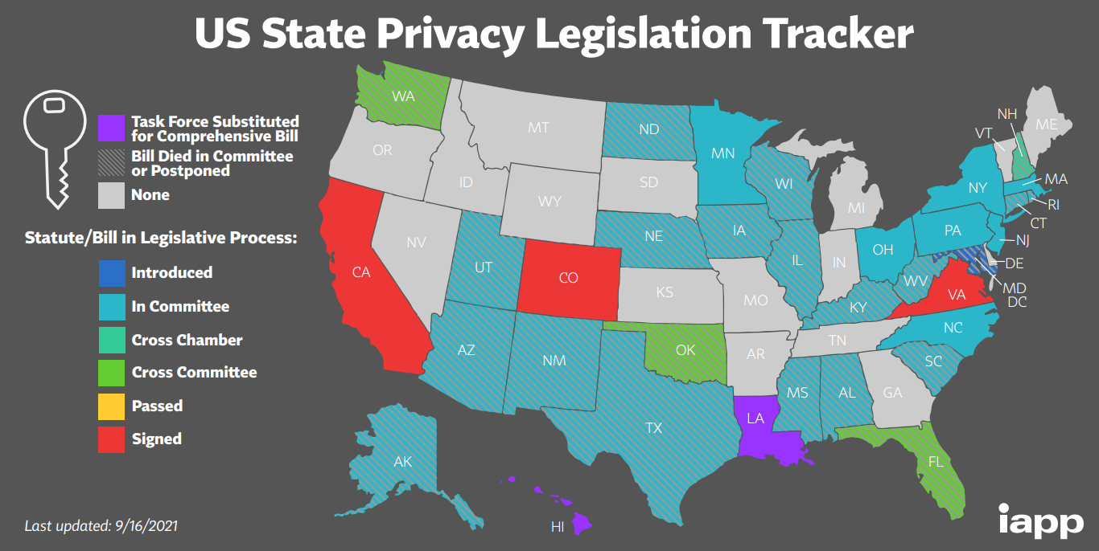
Why Do We Need Enterprise Data Governance?
Companies Now Must Protect Personally Identifiable Information (PII)
https://iapp.org/media/pdf/resource_center/State_Comp_Privacy_Law_Map.pdf

Slide 22
Agenda
What is data governance and why do we need it?
Requirements for governing data in a modern enterprise
A data governance framework
Managing master data
Technology needed for end-to-end data governance

Slide 23
Requirements for governing data
Data and entity definition – a common business vocabulary in a business glossary
Data and data entity identification / discovery
Data governance classification
People – Data ownership, stewardship and governance accountability
Processes – to govern data
Policies and rules to define how to data should be governed across the data lifecycle
Policy enforcement across the distributed data landscape
Master data management to get consistency across systems e.g. customer, product, supplier
Metadata lineage
Technology - to make it possible across datacenter, cloud and edge

Slide 24
Common vocabulary and business glossary
Is that with sales tax? Without it?
Can we have common names & definitions clearly defined in a business glossary?
Total sales
Sales
Gross revenue

Slide 25
Enterprise data governance is needed across data created and stored on-premises, in multiple clouds and at the edge
Common vocabulary, data quality, data privacy, data access security, data retention, data lineage
Enterprise data governance
Edge devices
Data center
Azure
AWS
Google Cloud

Slide 26
We need to know how to govern data across the enterprise
We need to see across the hybrid multi-cloud distributed data landscape including geographic location
Understand what data attributes, data entities and data relationships exist across the distributed data landscape
Classify the data to know how to govern it
Define policies to specify how data should be governed for each type of governance classification?
Enforcement of data quality, security and lifecycle management policies across the distributed data landscape
We need to know:
What is data being collected?
Where is the data stored?
For what business purpose?
How many copies exist?
How good/bad is the quality?
Where is the sensitive data?
Batch Load
Replicate
Streaming
SFTP

Slide 27
What do you need to know to govern and manage data across a distributed data landscape?
What data exists and where is it?
What data needs governed and managed?
How should it be classified, e.g. is it sensitive data such as PII, is it a trade secret?
If the data is structured, what data names is it known by and are there any common data names that it should it be known by?
How good or bad is the quality of the data?
Does it need to be cleaned, transformed, integrated and shared?
Who is responsible for doing that work?
What trusted data is available and how was it produced?
If the data changes should it be kept synchronised?
Who is allowed to access and change master data?
How much power do users have and how are users, applications and scripts audited?

Slide 28
Need data governance classification schemes to label data so you know how to govern it
Data confidentiality classification scheme
Data retention classification scheme
Confidential | Description
Public | Anyone can access, Can be sent to anyone e.g. open government data
Internal use only | Employees only can access Cannot be sent outside the company
Confidential | Should be shared only if needed for a specific task Cannot be sent outside the company without a non-disclosure agreement
Sensitive (PII) Personally identifiable information | Must be masked and shared only on a need to know basis for a limited time Cannot be sent to unauthorized personnel or outside the company
Restricted | Only to be shared with named individuals who are accountable for its protection e.g. legal documents, Trade secret (Coca Cola recipe)
Retention | Description
None | No need to keep the data
Temporary | Short lived e.g. keep twitter data for a week
Fixed period | Set number of years e.g. keep tax records for 7 years to comply with government laws after which it can be deleted
Permanent | Never to be deleted e.g. Legal correspondence

Slide 29
Roles and responsibilities for accountability
Who sets success metrics & monitors how well the governance program is working?
Who are the data owners?
Who defines and maintains a business glossary?
Who creates and maintains policies on access security?
Who is protecting PII data privacy for compliance with GDPR & CCPA?
Who is looking after the quality of product data across all brochures and partner websites?
Who ensures customer data is consistent across all systems?
Who is policing external subscription data usage vs license?
Who is policing privileged users like DBAs?
GRC Manager
CxO
Legal
Department head
IT
GRC = Governance, Risk and Compliance

Slide 30
Data governance processes
How do you govern definition and maintenance of a common business vocabulary?
How do you find out what data you have, what it means and where it is?
How do you classify data to know how to govern it?
How do you govern definition and maintenance of data access security policies?
How do you govern definition and maintenance of data privacy policies?
How do detect data quality problems and remediate them?
How do you apply policies to ensure action is taken for compliance?
How do you govern maintenance of master data?

Slide 31
Policies and rules to govern data
Data integrity rules
Data ingestion policies and rules
Data access security policies and rules
Data privacy policies and rules
Data quality policies and rules
Data maintenance policies and rules
Data retention policies and rules

Slide 32
Agenda
What is data governance and why do we need it?
Requirements for governing data in a modern enterprise
A data governance framework
Managing master data
Technology needed for end-to-end data governance

Slide 33
What is in a data governance framework?
Data governance vision and strategy
People
Processes
Policies
Technology
Data lifecycle
Data
Create
Protect
Store
Use
Maintain
Archive
Destroy
Edge
Data center
Multiple clouds

Slide 34
Vision and strategy
Data governance vision and strategy
People
Processes
Policies
Technology
Stakeholders
Vision statement
Data governance objectives
Data governance success metrics (KPIs) and targets
Risk management and compliance – quality, security, privacy and retention metrics
Value creation metrics
Business case – the impact ungoverned data is having on the business
Priorities – focus where ungoverned data has the greatest business impact
Cost, revenue and risk
Projects / initiatives to achieve the objectives
Budget
Leadership and accountability
Principles
Data lifecycle
Data
Edge
Data center
Multiple clouds

Slide 35
Data and the data lifecycle that needs to be governed
Data governance vision and strategy
People
Processes
Policies
Technology
Data entity examples
Customer
Product
Employee
Supplier
Order
Invoice
Payment
Asset
Risk
Documents examples
Supplier contract
Annual report
Product brochure
Data lifecycle
Create / Ingest
Protect
Store
Use
Maintain
Archive
Destroy
Data
Edge
Data center
Multiple clouds
Data
Lifecycle

Slide 36
Organizational roles and responsibilities
Data governance vision and strategy
People
Processes
Policies
Technology
Executive sponsor (e.g. CFO / CIO)
Data governance program leader (e.g. CDO)
Data governance control board (business stakeholders)
Data governance working groups
Data owners
Business data stewards
Data Protection Officer (DPO)
Data security team
Data publishing manager
Data lifecycle
Data
Edge
Data center
Multiple clouds

Slide 37
Data governance roles and responsibilities (guidance only)
Role | Responsibility
Executive sponsor (e.g. CFO / CIO) | Senior business stakeholder with authority and budget who is accountable for ensuring data governance is established
Data Governance program leader (e.g. CDO or appointed lead) | The person with overall accountability and responsibility for implementing the data governance program.
Data Governance Control Board | Includes data governance lead and data owners. Sets success metrics, owns the data governance roadmap, selects working groups, holds the budget for the data governance program, arbitrates when conflicts occur on priorities and definitions of cross functional data
Data Governance Working Group | Plan and progress data improvement of a specific data domain, update Data Governance Control Board on progress, manage stewardship across the enterprise for a specific domain
Data owner | Senior business stakeholder with authority and budget who is accountable for overseeing the quality and protection of a specific data subject area or data entity across the enterprise and make decisions on who has the right to access and maintain that data and on how it is used
Business data steward | Business profession responsible for overseeing the quality and protection of a data subject area or data entity. They are typically experts in the data domain and work in a team with other data stewards across the enterprise to monitor and make decisions to ensure data quality is maintained
Data Protection Officer (DPO) | Senior business stakeholder with authority and budget who is accountable for the protection of personal data specific to compliance legislation in all jurisdictions that the company operates
Data security team | Responsible and accountable for data access security and data privacy policy enforcement
Data Publishing Manager | Responsible and accountable for quality assurance checking and publishing of newly created trusted data assets in a data marketplace for consumers to find and use

Slide 38
Control board and working groups (guidance only)
Executive
Data Governance Control Board
DG Leader
Data owners
IT Data Lead
Selected SMEs
e.g. Lead Data Architect
Data Governance Working Group
Data Governance Working Group
Domain
Data Steward(s)
Data owner
IT Data Architect
Business Domain SMEs
Domain
Data Steward(s)
Data owner
IT Data Architect
Business Domain SMEs
…
…
Multiple working groups

Slide 39
Data entity based approach (guidance only)
Dispute resolution process to overcome disagreements
Control board approval processes for data naming, integrity rules, policies…
Sponsor
(CIO / CDO)
Operating model is independent of location and line of business
Dispute resolution process
Enterprise Data Gov Control Board
Customer
Product
Orders
Dispute resolution process
Domain
Data Steward(s)
Data owner
IT Data Architect
Business Domain SMEs
Dispute resolution process
Domain
Data Steward(s)
Data owner
IT Data Architect
Business Domain SMEs
Dispute resolution process
Domain
Data Steward(s)
Data owner
IT Data Architect
Business Domain SMEs
Data Gov Working Group
Data Gov Working Group
Data Gov Working Group
Business data steward
Business data steward
Business data steward
Business data steward
Business data steward
Business data steward
Customer
Product
Orders
Virtual SME community
Virtual SME community
Virtual SME community

Slide 40
Data governance processes and how they apply to the data lifecycle
Discovery processes
Definition processes
Policy and rule application / enforcement
Monitoring processes

Slide 41
Data governance processes and how they apply to the data lifecycle
Discovery processes
Data and data entity discovery, mapping and cataloguing
Data profiling to determine quality
Sensitive data discovery and governance classification
Data maintenance discovery for CRUD analysis (e.g. from log files)
Data governance definition processes
Create and maintain common business vocabulary in a business glossary
Data entities (including master data), data attribute names, integrity rules and valid formats
Define reference data - to standardise code sets across the enterprise
Define data governance classifications schemes to label data to determine how to govern it
Define data governance policies and rules to govern data entity and document lifecycles
Define success metrics and thresholds
Data governance vision and strategy
People
Processes
Policies
Technology
Data lifecycle
Data
Edge
Data center
Multiple clouds

Slide 42
Data governance processes and how they apply to the data lifecycle
Data governance policy and rule application / enforcement processes
Automated application / enforcement of policies and rules
Manual application and enforcement of policies and rules
Event-driven, on-demand and timer-driven (batch) data governance services
Govern data ingestion - cataloguing, classification, owner assignment, and storing
Govern data quality
Govern data access security
Govern data privacy
Govern data usage e.g. including sharing and to ensure licensed data is only used for approved purposes
Govern data maintenance
Govern data retention
Govern master data and reference data synchronization
Monitoring processes
Monitor and audit data usage activity, quality, access security, privacy, maintenance and retention
Policy rule violation detection and resolution

Slide 43
Defining data entities in a common business vocabulary
Data governance working groups will include a mix of IT and business user SMEs
DG working group
DG working group
DG working group
Owner
SMEs
Stewards
Owner
SMEs
Steward
Owner
SMEs
Stewards
Customer
Product
Supplier
Business Glossary
Policies & rules
Data governance working groups will include a mix of IT and business users/ SMEs
Data catalog
Owner
SMEs
Stewards
Owner
SMEs
Steward
DG working group
DG working group
Order
Shipment
SME = subject matter expert

Slide 44


Integration of the catalog business glossary with other technologies is needed for consistent data names
Data
virtualization
Note that naming standards and a metadata information model are needed to share metadata across multiple catalogues, platforms, tools and applications is needed
Enterprise service bus
& IPaaS software
Operational app’n
services & APIs
(e.g. swagger files)
e.g. Hive Tables
Data science workbenches
publish
Self-service data prep tools
Software development
tools
UML
IDE plug-in
metrics, dimensions
BI tools
Business glossary
Data catalog
R
asset
mart
mart
C
prod
cust
U
D
DW
MDM
Data warehouse
NoSQL DBMS
RDBMS
ETL tools
Data Modelling

Slide 45
We need a data catalog to automatically discover, find, and govern access to data across the landscape
Enterprise Data Governance
Data catalog
Crawling data store
Edge devices
Data center
Azure
AWS
Google Cloud

Slide 46
We need to discover what data exists in which systems, where it is across the data landscape, and how it represents data entities
Source system 1
Source system 2
Source system 3
Attribute 1
Attribute 2
.
.
.
Attribute n
Attribute 1
Attribute 2
.
.
Attribute n
Attribute 1
Attribute 2
.
.
Attribute n
Customer
Supplier
Product
Order
Identify data attributes in source data systems and derive data entities
This makes mapping easier and enforces rigor based on the Common Vocabulary

Slide 47
Use AI to automatically classify data to know how to govern it
Source System 1
Source System 2
Source System 3
Attribute 1
Attribute 2
.
.
.
Attribute n
Attribute 1
Attribute 2
.
.
Attribute n
Attribute 1
Attribute 2
.
.
Attribute n
Customer
Supplier
Product
Order
Sensitive (PII)
Identify data attributes in source data systems and derive data entities
This makes mapping easier and enforces rigor based on the Common Vocabulary

Slide 48
Data governance policy authoring processes
Data governance vision and strategy
Data governance policies describe a set of rules to control the integrity, quality, access security, privacy and retention of data
Data governance policy types
Data integrity policies
Data quality policies
Data access security policies
Data privacy policies
Data retention policies
Multiple versions of policies may be needed across different jurisdictions
People
Processes
Policies
Technology
Data lifecycle
Data
Edge
Data center
Multiple clouds
Customer data
Attach tags to data
Sensitive (PII)
Attach policies to tags
policy
policy
policy
Attach rules to a policy
rule
rule
rule

Slide 49
Types of rules used to implement policies
Data integrity constraints
e.g. valid values, referential integrity
Data quality rules
Data standardization rules (e.g., a phone number: 800-123-1234)
Data cleansing rules
Data matching and integration rules
Data protection rules
Data access security rules
Data privacy rules
Data provisioning rules
Data lifecycle management rules
Data retention rules
Data archive and backup rules
policy
rule
rule
rule

Slide 50
Ideally, a common data fabric that can connect to data stores across the data landscape could enforce the DG policies and rules everywhere
DG policies
Common vocabulary • Data quality • Data privacy • Data access security • Data retention
Enterprise data fabric
Data catalog
Policies & rules
Edge devices
Data center
Azure
AWS
Google Cloud

Slide 51
Monitor and audit data activity
Data entity examples
Customer
Product
Employee
Supplier
Order
Invoice
Payment
Asset
Create / Ingest
Data steward dashboards
Destroy
Protect
Data
Lifecycle
Archive
Store
Monitor data quality, privacy, access security, usage, maintenance and retention of specific data entities through their lifecycles
Maintain
Use
Edge
Data center
Multiple clouds

Slide 52
Continual update of the catalog plus governance ML for real-time detection allows monitoring of data activity
Automated data governance actions
Data steward dashboards
DG alerts & recommendations
Enterprise Data Governance
Data catalog
Edge devices
Data center
Azure
AWS
Google Cloud

Slide 53
Policy violation detection and resolution
Manual data governance
e.g. Data steward manual data correction
Machine learning for data governance automation
Automated detection of poor quality data
Automated data correction
Guide data stewardship decisions using recommendations
Automate mundane data stewardship tasks e.g. master data matching
Self-learning data steward
Observe data stewardship decisions and learn from these

Slide 54
Technology of data governance
Data governance vision and strategy
People
Processes
Policies
Technology
Data catalog that includes:
Business glossary
Auto data discovery, profiling, tagging, cataloguing and mapping to a glossary
Auto entity discovery
Auto sensitive data detection and governance classification
Data lake to ingest data
Enterprise data fabric software
Datacenter, multi-cloud and edge connectivity
Data stewardship tooling
Data cleansing and integration
Metadata lineage
Data privacy masking service
Universal data access security across multiple data stores in a distributed data landscape
Data stores with data encryption, dynamic data masking and integration with the catalog
AI assisted data governance
Master and reference data management
Data lifecycle
Data
Edge
Data center
Multiple clouds

Slide 55
Agenda
What is data governance and why do we need it?
Requirements for governing data in a modern enterprise
A data governance framework
Managing master data
Technology needed for end-to-end data governance

Slide 56
The requirement is for integrated commonly defined master data held in central master data stores
Centralized multi-domain
Master Data Management
supplier
customer
Operational
transaction processing systems
(subsets of master data)
Common master data definitions
asset
Master data integration
product
Capture, standardise, clean, de-duplicate, prepare comparison data, match, integrate
…

Slide 57
Managing master data
Control maintenance via data access security
Create, update, delete
Master data discovery, curation, storage, publishing
Master data synchronization
Master data maintenance discovery via business process identification and CRUD analysis
Often a manual task
Now helped by the emergence of process mining and analysing database log files
Governing maintenance of master data
CRM
Distribution system
ERP
Master Data
Customer, supplier, product
Data Warehouse & mart
SCM
Data Science
Manufacturing systems

Slide 58
Governing GDPR consent management in MDM
Need to collect consent from applications and match with master data
Collect master data and consent from all applications that request it, store all consent with the master data record
Master data
Application
R
e.g. web site
Mask sensitive data
Customer
Consent
Master data integration
Application
C
U
Customer consent tables
Additional consent management tables in the MDM system
Capture, standardise, clean, de-duplicate, prepare comparison data, match, integrate
Application
D
Log
Log of all master data updates including opt-ins
CRUD = Create, Read, Update, Delete (common services around master data)

Slide 59
Progress through the data governance maturity model
 | Ungoverned | Stage 1 | Stage 2 | Fully governed
People | No stakeholder executive sponsor | Stakeholder sponsor in place | Stakeholder sponsor in place | Stakeholder sponsor in place
 | No roles and responsibilities defined | Roles and responsibilities defined | Roles and responsibilities defined | Roles and responsibilities defined
 | No DG control board | DG control board in place but no ability | DG control board in place with data | DG control board in place with data
 | No DG working groups | No DG working groups | Some DG working groups in place | All DG working groups in place
 | No data owners accountable for data | No data owners accountable for data | Some data owners in place | All data owners in place
 | No data stewards appointed with responsibility for data quality | Some data stewards in place for DQ but scope too broad e.g. whole dept | Data stewards in place and assigned to DG working groups for specific data | Data stewards in place assigned to DG working groups for specific data
 | No one accountable for data privacy | No one accountable for data privacy | CPO accountable for privacy (no tools) | CPO accountable for privacy with tools
 | No one accountable for access security | IT accountable for access security | IT Sec accountable for access security | IT Sec accountable for access security & responsible for enforcing privacy
 | No one to produce trusted data assets | Data publisher identified and accountable for producing trusted data | Data publisher identified and accountable for producing trusted data | Data publisher identified and accountable for producing trusted data
 | No SMEs identified for data entities | Some SMEs identified but not engaged | SMEs identified & in DG working groups | SMEs identified & in DG working groups
Process | No common business vocabulary | Common biz vocabulary started in a glossary | Common business vocabulary established | Common business vocabulary complete
 | No way to know where data is located, its data quality or if it is sensitive data | Data catalog auto data discovery, profiling & sensitive data detection on some systems | Data catalog auto data discovery, profiling & sensitive data detection on all structured data | Data catalog auto data discovery, profiling & sensitive data detection on structured & unstructured in all systems w/ full auto tagging
 | No process to govern authoring or maintenance of policies and rules | Governance of data access security policy authoring & maintenance on some systems | Governance of data access security, privacy & retention policy authoring & maintenance | Governance of data access security, privacy & retention policy authoring & maintenance
 | No way to enforce policies & rules | Piecemeal enforcement of data access security policies & rules across systems with no catalog integration | Enforcement of data access security and privacy policies and rules across systems with catalog integration | Enforcement of data access security, privacy & retention policies and rules across all systems
 | No processes to monitor data quality, data privacy or data access security | Some ability to monitor data quality Some ability to monitor privacy (e.g. queries) | Monitoring and stewardship of DQ & data privacy on core systems with DBMS masking | Monitoring and stewardship of DQ & data privacy on all systems with dynamic masking
 | No availability of fully trusted data assets | Dev started on a small set of trusted data assets using data fabric software | Several core trusted data assets created using data fabric | Continuous delivery of trusted data assets with enterprise data marketplace
 | No way to know if a policy violation occurred or process to act if it did | Data access security violation detection in some systems | Data access security violation detection in all systems | Data access security violation detection in all systems
 | No vulnerability testing process | Limited vulnerability testing process | Vulnerability testing process on all systems | Vulnerability testing process on all systems
 | No common process for master data creation, maintenance & sync | MDM with common master data CRUD & sync processes for single entity | MDM with common master data CRUD & sync processes for some data entities | MDM with common master data CRUD & sync processes for all master data entities complete

Slide 60
Progress through the data governance maturity model
 | Ungoverned | Stage 1 | Stage 2 | Fully governed
Policies | No data governance classification schemes on confidentiality & retention | Data governance classification scheme for confidentiality | Data governance classification scheme for both confidentiality and retention | Data governance classification scheme for both confidentiality and retention
 | No policies & rules to govern data quality | Policies & rules to govern data quality started in common vocabulary in business glossary | Policies & rules to govern data quality defined in common vocabulary in catalog biz glossary | Policies & rules to govern data quality defined in common vocabulary in catalog biz glossary
 | No policies & rules to govern data access security | Some policies & rules to govern data access security created in different technologies | Policies & rules to govern data access security & data privacy consolidated in the data catalog using classification scheme | Policies & rules to govern data access security, data privacy and retention consolidated in the data catalog using classification schemes and enforced everywhere
 | No policies & rules to govern data privacy | Some policies & rules to govern data privacy | Policies & rules to govern data access security & data privacy consolidated in the data catalog using classification scheme | Policies & rules to govern data access security, data privacy and retention consolidated in the data catalog using classification schemes and enforced everywhere
 | No policies & rules to govern data retention | No policies & rules to govern data retention | Some policies & rules to govern data retention | Policies & rules to govern data access security, data privacy and retention consolidated in the data catalog using classification schemes and enforced everywhere
 | No policies & rules to govern master data maintenance | Policies & rules to govern master data maintenance for a single master data entity | Policies & rules to govern master data maintenance for some master data entities | Policies & rules to govern master data maintenance for all master data entities
Technology | No data catalog with auto data discovery, profiling & sensitive data detection | Data catalog with auto data discovery, profiling & sensitive data detection purchased | Data catalog with auto data discovery, profiling & sensitive data detection purchased | Data catalog with auto data discovery, profiling & sensitive data detection purchased
 | No data fabric software with multi-cloud edge and data centre connectivity | Data fabric software with multi-cloud edge and data centre connectivity & catalog integration purchased | Data fabric software with multi-cloud edge and data centre connectivity & catalog integration purchased | Data fabric software with multi-cloud edge and data center connectivity & catalog integration purchased
 | No metadata lineage | Metadata lineage available in data catalog on trusted assets being developed using fabric | Metadata lineage available in data catalog on trusted assets being developed using fabric | Metadata lineage available in data catalog on trusted assets being developed using fabric
 | No data stewardship tools | Data stewardship tools available as part of the data fabric software | Data stewardship tools available as part of the data fabric software | Data stewardship tools available as part of the data fabric software
 | No data access security tool | Data access security in multiple technologies | Data access security in multiple technologies | Data access security enforced in all systems
 | No data privacy enforcement software | No data privacy enforcement software | Data privacy enforcement in some DBMSs | Data privacy enforcement in all data stores
 | No master data management system | Single entity master data management system | Multi-entity master data management system | Multi-entity master data management system

Slide 61
Agenda
What is data governance and why do we need it?
Requirements for governing data in a modern enterprise
A data governance framework
Managing master data
Technology needed for end-to-end data governance

Slide 62



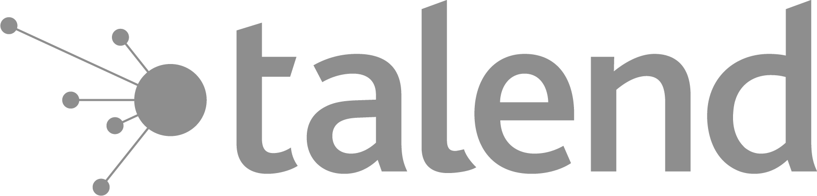

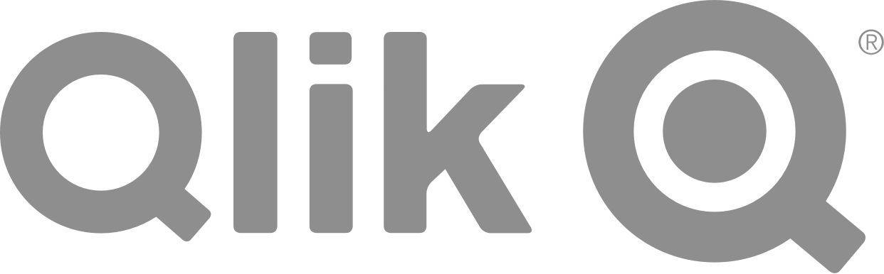



Technology needed for end-to-end data governance
Partner technologies on Azure
(ETL, Data cataloging)
Microsoft Common Data Model
Azure Data Lake Storage
Master Data Services
Azure Data Factory
Enterprise data cataloging

Slide 63
Azure Purview: Unified Data Governance
Azure Purview
Power BI
SQL Server on-prem
Azure Synapse
Azure Data Services
M365 Compliance Center
Unified Experience
Data Catalog
Data Insights
Search
Business Glossary
Lineage
Data use reports
Publish, Discover & Curate Data
Unified Platform
“Data Map” = Data Assets | Lineage | Classifications
Open APIs
Automated Scanning & Classification
(Apache Atlas 2.0)
On-prem & Multicloud Operational, Analytical, SaaS

Slide 64
Thank you!
Modern Analytics Academy “Vignettes”
Data Governance Overview
https://aka.ms/maa

